Slide 1




NEXT GEN EMPLOYABILITY PROGRAM
Creating a future-ready workforce
Team Members
College Name
Student Name : J.Athira
Student ID : au960221243011
Arunachala college of engineering for women

Slide 2

CAPSTONE PROJECT SHOWCASE
Project Title
Car Rentals Application with Django Framework
Abstract | Problem Statement | Project Overview | Proposed Solution | Technology Used | Modelling & Results | Conclusion

Slide 3
Abstract The advancement of technology has revolutionized various industries, including the transportation sector. Car rental businesses are no exception, where the efficient management of vehicles, bookings, and customer information is crucial for success. This project proposes the development of a comprehensive car rental application using the Django framework, a high-level Python web framework known for its simplicity and scalability. The proposed system aims to streamline the process of managing car rentals for both customers and administrators. Customers will have access to an intuitive user interface where they can browse available vehicles, make reservations, view rental history, and manage their profiles. On the other hand, administrators will have full control over the system, allowing them to add new vehicles, manage bookings, track payments, and generate reports. .
Source :

Slide 4
Problem Statement 1.Car rental businesses face operational inefficiencies: 2.Manual booking processes lead to errors and delays. 3.Inadequate vehicle management systems result in underutilization and increased costs. 4.Disjointed customer interaction platforms cause communication inconsistencies.
Source :

Slide 5
Project Overview Objective: Modernize and optimize car rental operations through a Django-based application. Key Features: 1.User Authentication & Authorization. 2.Vehicle Management. 3.Booking System. 4.Payment Integration. 5.Rental History & Profile Management. 6.Reporting & Analytics. Technical Overview: 1.Built on Django framework. 2.Utilizes built-in features for efficiency. 3.Integrates third-party libraries for payment and reporting.
Source :

Slide 6
Proposed Solution 1.Develop a comprehensive car rental application using Django framework: 2,Automate booking processes to eliminate errors and delays. 3.Implement robust vehicle management systems for optimal fleet utilization. 4.Integrate a centralized platform for seamless customer interaction.
.
Source :

Slide 7
User Authentication & Authorization: Implement secure login for customers and administrators to access respective functionalities.
Vehicle Management: Create a comprehensive system to add, edit, and manage vehicle listings including availability status.
Booking System: Enable customers to search for available vehicles based on location and date, make reservations, and receive confirmation.
Payment Integration: Integrate payment gateways to facilitate secure online transactions for booking payments.
Rental History & Profile Management: Allow users to view their rental history, manage profiles, and update personal information.
Admin Dashboard: Provide administrators with a dashboard to monitor bookings, manage vehicles, and generate reports.
Source :

Slide 8
Technical Implementation:
Utilize Django's built-in features such as authentication, ORM, and templating for rapid development.
Integrate third-party libraries for payment processing and user interface enhancements.
Ensure scalability and security by following best practices in Django development.
Host the website on a reliable server and implement regular backups and security updates
Source :

Slide 9


Technology Used
Front-end
Back-end
Source :

Slide 10
Modelling & Results Modeling: Define database models for vehicles, bookings, and users using Django's ORM. Implement booking process, user authentication, and authorization functionalities. Implementation: Develop CRUD functionalities for vehicle management. Integrate secure payment gateways for online transactions. Ensure responsive design and accessibility for optimal user experience. Testing and Validation: Conduct thorough testing to ensure functionality, performance, and security. Gather feedback from users and stakeholders to refine the website. Results and Feedback: Measure key metrics such as booking conversion rates and user engagement. Iterate based on feedback to continuously improve the website's usability and effectiveness.
Source :

Slide 11
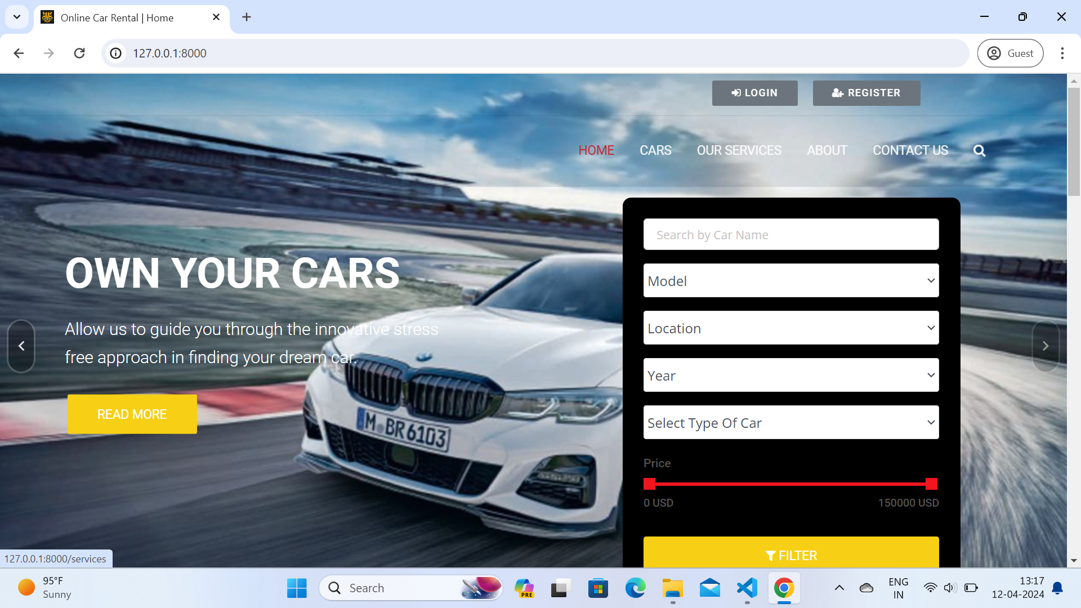
Homepage

Slide 12
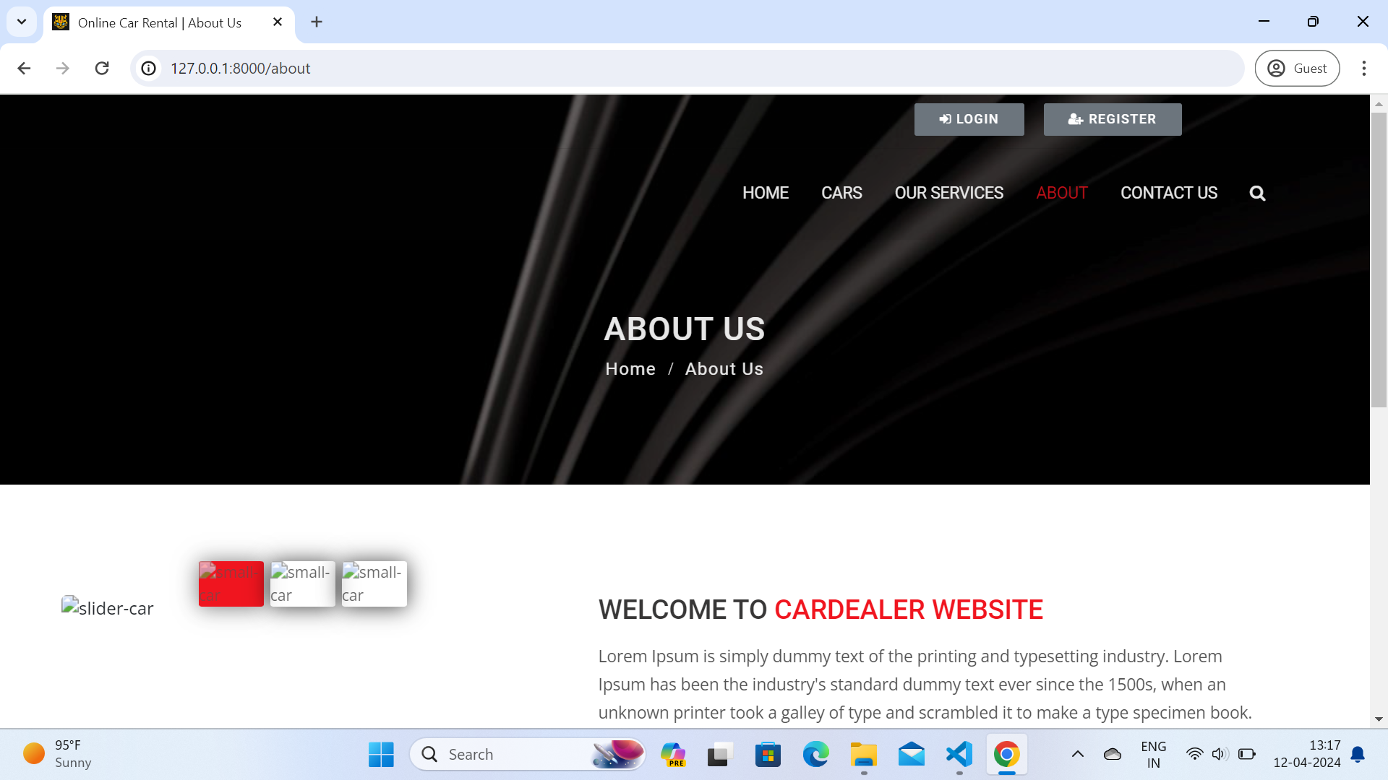
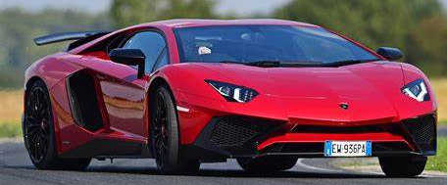
About-Us-Page

Slide 13
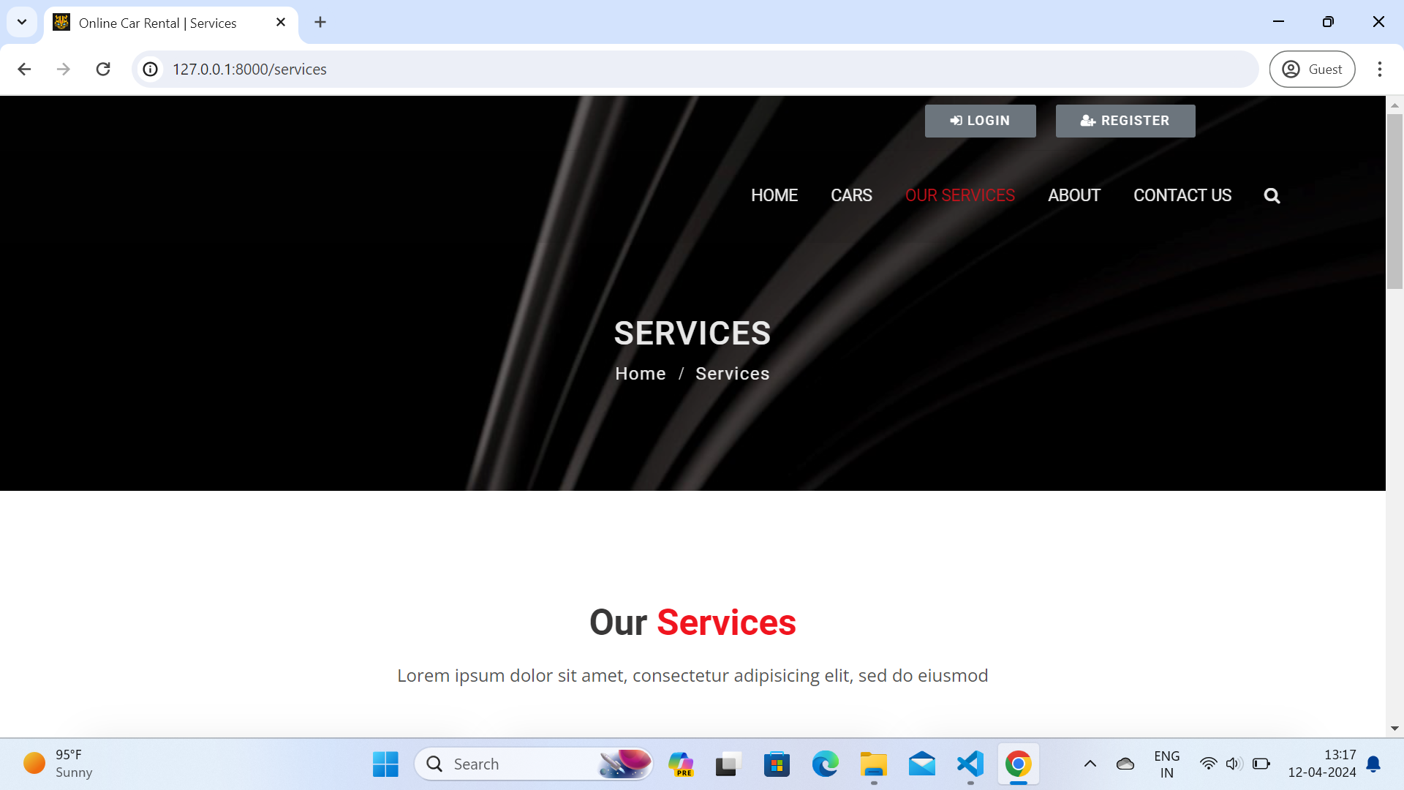
Service-Page

Slide 14
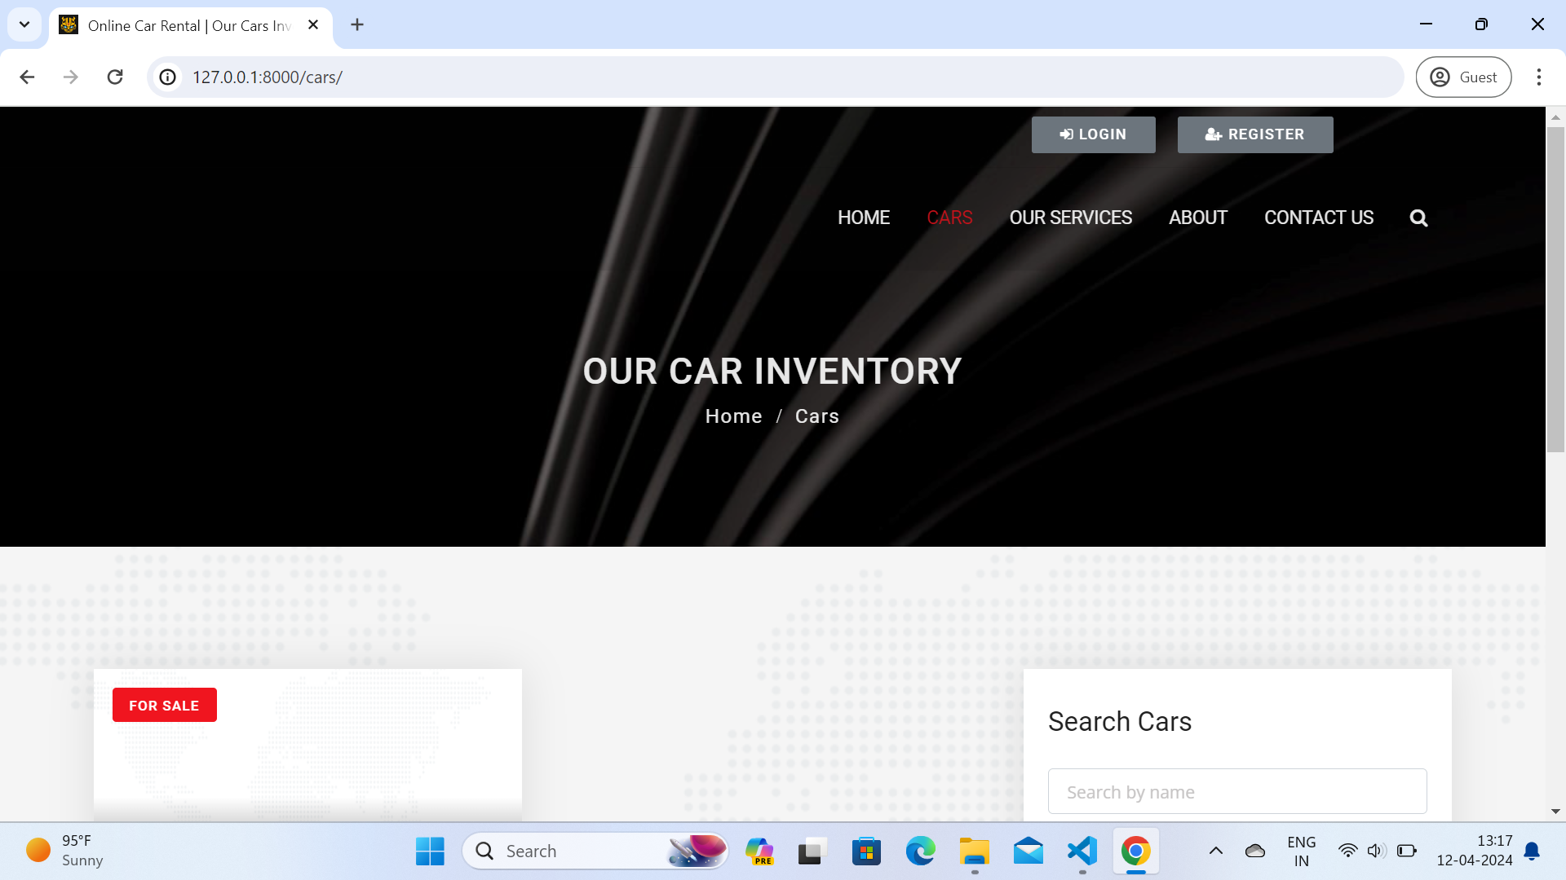
Departments-Page

Slide 15
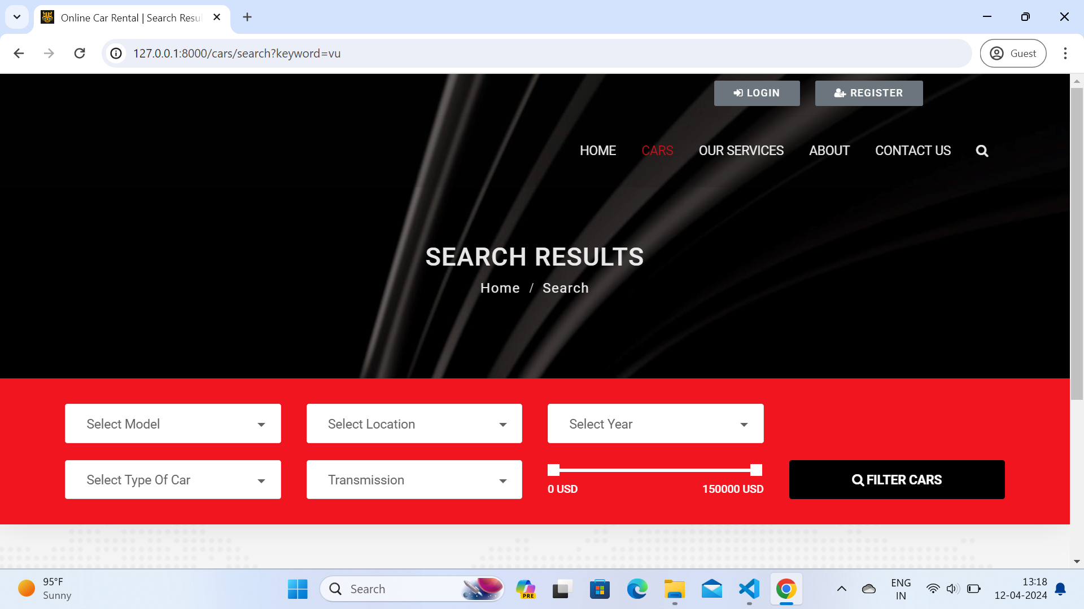
Blog-Page

Slide 16
Future Enhancements:
Integration with IoT Devices: Integrating Internet of Things (IoT) devices into rental vehicles can provide real-time data on vehicle health, location, and usage metrics, allowing for proactive maintenance, improved safety, and enhanced fleet management capabilities.
Green Initiatives: Introducing eco-friendly vehicle options, promoting carpooling initiatives, or implementing carbon offset programs can appeal to environmentally conscious customers and align with corporate social responsibility goals.

Slide 17
Conclusion
In conclusion, the implementation of a car rental web application system using Django presents a comprehensive solution to the complexities of managing rental services online. Through its modular design and extensive feature set, this system empowers rental businesses to efficiently handle inventory, bookings, and customer interactions while providing a seamless experience for users.
Source :

Slide 18
Thank You!
Notes:
Thank You !!

